Slide 1
DETECTION OF CONSTRUCTIVE AND NON CONSTRUCTIVE REVIEWS
NAME:SIVASUBRAMANIAN KANDASWAMI
PATTERN RECOGNITION COURSE
EEL 6825, SPRING 2016

Slide 2
INTRODUCTION
MOTIVATION
DATASET PREPARATION
FEATURE EXTRACTION
FEATURE NORMALIZATION
CLASSIFIERS

Slide 3

MOTIVATION
Sales on Online platforms are growing by huge amounts.
Reviews form an integral part of the online sales and services
Potential Customers depend heavily on User Reviews.
Listing reviews in chronological order is not useful.
Identifying reviews that are comprehensive, informative and clear is an important step.
This can increase customer satisfaction and loyalty to the platform eg. Amazon, Tripadvisor etc.

Slide 4
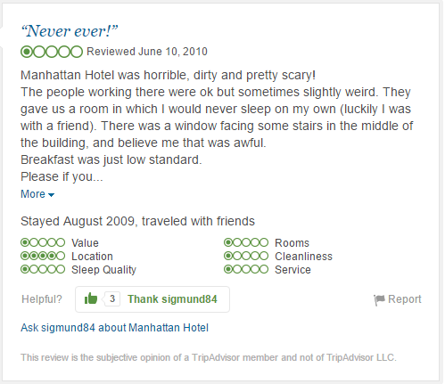
EXTRACTION OF DATA
Dataset from TripAdvisor
Why TripAdvisor?

Slide 5
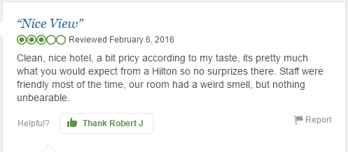

HELPFUL AND NOT AS HELPFUL REVIEWS

Slide 6
FEATURES EXTRACTED
REVIEW CONTENT
IMPORTANT THEMES COVERED IN REVIEW
REVIEW LENGTH
SUBJECTIVITY AND OBJECTIVITY
OVERALL RATING OF THE REVIEW

Slide 7
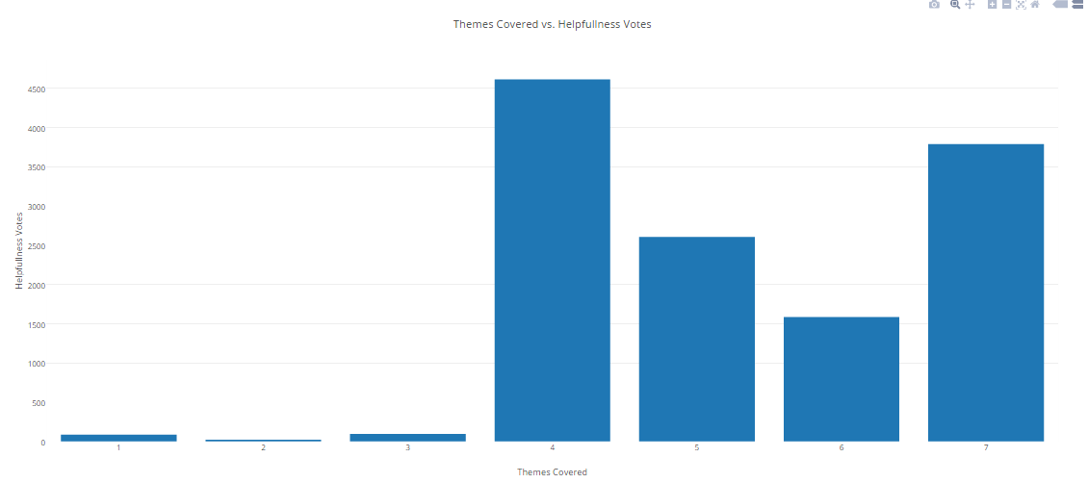
THEMES COVERED IN REVIEW

Slide 8
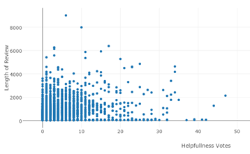
LENGTH FEATURE

Slide 9
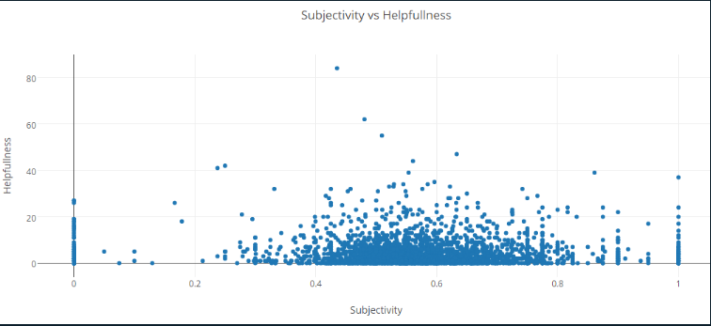
SUBJECTIVITY

Slide 10

NORMALIZING THE DATA
The range of values of feature data varies widely
Eg. Before processing the data
The length feature : Usually lies between 50 – 8000 words.
Themes Covered: Lies between 0 and 7
Subjectivity: Lies between -1 and 1
X’ REPRESENTS THE NORMALIZED DATA

Slide 11
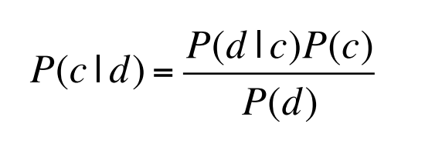

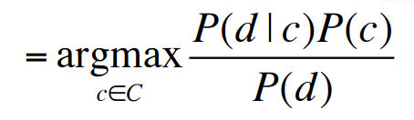
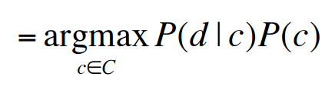
NAÏVE BAYESIAN CLASSIFIER
D: Document
C: Class
MAP: MAXIMUM POSTERIORI
APPLYING THE BAYES RULE, AND REMOVING THE DENOMINATOR

Slide 12
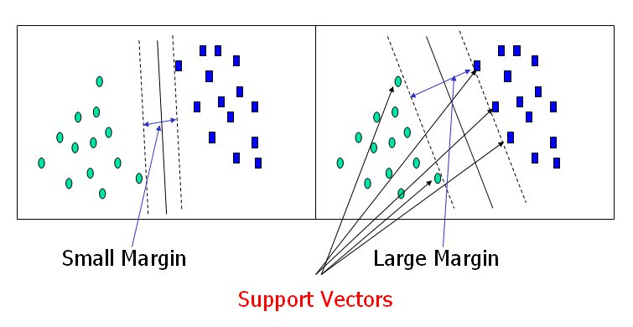
SUPPORT VECTOR MACHINES
What are Support Vectors?
Support vectors define the Hyperplane

Slide 13
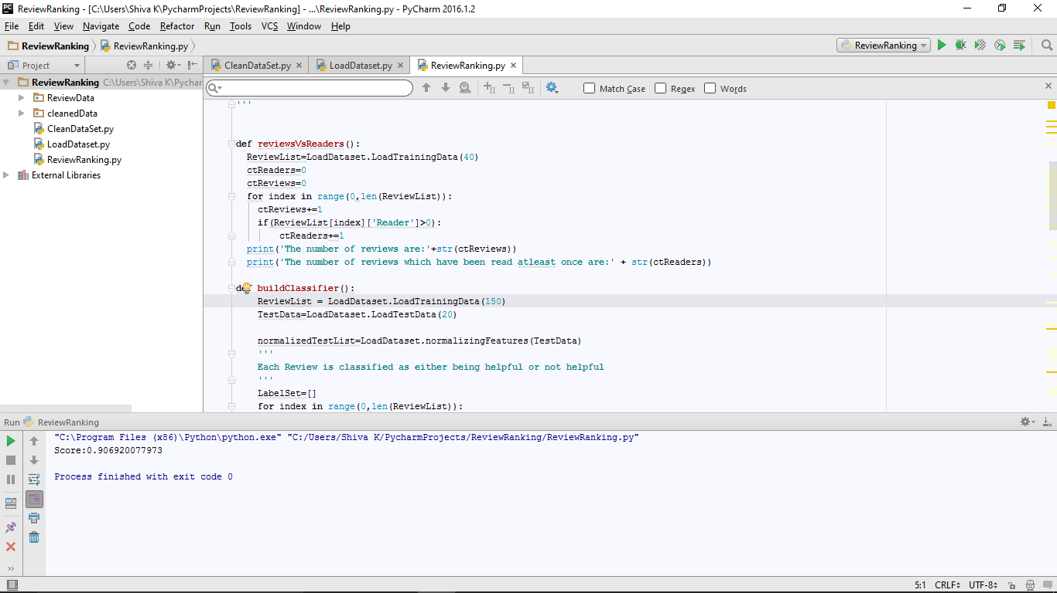
SVM CLASSIFIER SCORE

Slide 14
FUTURE WORK
We can attempt the classification with several other classifiers to see find the best method.
Adding n gram analysis

